Slide 1
Transfer of Medical Devices Manufacturing Technology
Luca Passaggio, Lugano, Switzerland
3rd WHO Global Forum on Medical Devices
Geneva, Switzerland, 10 - 12 May, 2017.

Slide 2
Disclosure
Source of funding: LP Medical Consulting Sagl, Lugano, Switzerland.
Conflict of interest: the Author is CEO and shareholder of LP Medical Consulting Sagl, Lugano, Switzerland, a company involved, among other activities, also in the transfer of technology of medical devices.

Slide 3
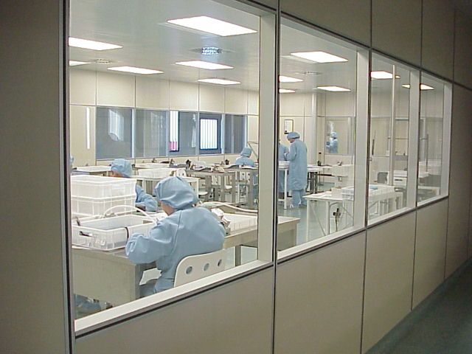
Technology Transfer
The capacity of one country or organization to adopt and replicate the technology, knowledge and skills from another, with the aim to improve, modify and expand further.

Slide 4
Technology Transfer
It is not only related to establishing new industries, but especially to develop human resources, services and the standard of living, while improving existing science and technology to achieve self-reliance.
The first step of a technology transfer is the choice of the best possible channel; this depends upon many factors, the main issues being:
The availability of local financial and human resources;
The presence of local raw materials and services;
The choice of what degree of control is acceptable for the recipient country or organization.

Slide 5
Technology Transfer
There are three main accepted channels of transfer of manufacturing technology:
Joint venture agreements
licensing agreements
turn-key plants
Another channel is to establish foreign subsidiaries, but this is usually controlled by the donor and not by the recipient country or organization.
RECIPIENT
CHANNELS
DONOR

Slide 6
Channels - JV
A joint venture (JV) is a partnership arrangement between two or more parties to undertake economic activity together in order to manufacture or sell a product and to share profits and risks.
The parties agree to create a new entity by both contributing equity, and by sharing in the revenues and expenses.
Both parties share the control of the enterprise.
The joint venture can be for one specific project, or it can consist in a continuing business relationship.

Slide 7
Channels - JV
The formation of a joint venture usually involves the following steps:
Recognition of opportunities
Swot analysis
Market research
Partner search
Feasibility study for the proposed venture
Business planning
Memorandum of Understanding (MOU)
Due diligence
JV agreement
Implementation

Slide 8
Channels - JV
According to a survey of the United Nations Centre on Transnational Corporations, multinational corporations rank the importance of a local partner's contributions on:
Knowledge of the local political environment, economy AND local customs
Relations with the Government of host country
General management/ Marketing personnel
Local capital
Facilities and land of local partner
Capability of recruiting local manpower
Access to local raw materials
Access to local financial institutions
Notes:
In order to have a successful joint venture, it is always recommended for a technology recipient to choose a foreign partner with a prior experience.

Slide 9
Channels - Licensing
According to World Intellectual Property Organization (WIPO), "a license means the consent given by the owner of an exclusive right (licensor) to another person or legal entity (licensee) to perform certain acts which are covered by an exclusive right, or consent as to use of know-how”.
This means that a technology license is the right to use a know-how, a trademark or one or more patents on agreed conditions between the licensor (technology donor) and the licensee (technology recipient).

Slide 10
Channels - Licensing
Pros
The licensee obtains proprietary knowledge and know-how
The risk is calculated before the investment
Low R/D investment - lower financial needs
Fast to get to production
Training of specialized personnel possible before production
Effective way to diversify production
Cons
License fees required
Possible high costs for exclusive technology
Possible limitation of marketing imposed by the technology donor
Extensive training required
Notes:
The technology licensing agreement may be also part of a joint-venture or a turn-key contract, or it can be acquired directly for a certain fee (a lump-sum or a series of payments and/or royalties).

Slide 11
Channels – Turn-key Plants
A turn-key plant is a manufacturing plant that is constructed by a technology donor and sold or turned over to a buyer in a ready-to-use condition.
The turn-key plant involves a technology donor (a consulting or a contracting firm) implementing all the steps required for establishing a plant in a recipient country.
The technology selected in the turn-key plant has to be economically feasible and commercially proven. It is preferred that the contractor is either the owner of the technology or the main supplier of plant equipment and machinery.

Slide 12
Channels – Turn-key Plants
The realization of a turn-key plant usually involves the following steps:
Technical and Economic feasibility study
selection of the technology and donor
Detailed engineering and design
Plant construction
Evaluation and acceptance by the client
pRe-Production operations / training
It is important to remember that a turn-key plant does not provide a continuous involvement of the technology donor because the turn-key contract, in general, does not contain a commitment to provide services that may be needed for further growth.

Slide 13
Technology Transfer
The transfer of manufacturing technology within the domain of medical devices involves other concepts and algorithms, as the initial export of the device to the recipient country; a feasibility study needs to be carried out, involving a market study, the analysis of the economic environment, capital outlays, production costs, financial analysis and a strategic marketing plan.
There is no successful industrial investment without THE right strategic marketing plan!

