Slide 1
Transfer of Technology of Commoditized Medical Devices
Luca Passaggio, Lugano, Switzerland
4th WHO Global Forum on Medical Devices
Visakhapatnam, India, 13 - 15 December 2018

Slide 2
Disclosure
Source of funding: LP Medical Consulting Sagl, Lugano, Switzerland.
Conflict of interest: the Author is CEO and shareholder of LP Medical Consulting Sagl, Lugano, Switzerland, a company involved, among other activities, also in the transfer of technology of medical devices.

Slide 3
Technology Transfer
The capacity of one country or organization to adopt and replicate the technology, knowledge and skills from another, with the aim to improve, modify and expand further.

Slide 4
Commoditization Process
Commoditization is the process by which goods (in our case medical devices) that have economic value and are unique or innovative, end up becoming simple commodities.
Commoditized medical devices have thin margins, are sold because of price, and not brand. We are speaking about common technology, with no IP involved.

Slide 5
Commoditized Medical Devices
Surgical sutures
Surgical meshes
Trocars for laparoscopy
Disposable instruments and accessories for laparoscopy
Intravenous catheters & accessories
Infusion sets
Transfusion sets
Three-way stopcocks
Kits for epidural & combined anaesthesia
Spinal needles
Central venous catheters 1 - 2 - 3 - 4 - 5 lumen
Peripherally inserted central venous catheters (PICC)
Parenteral nutrition bags
Catheters for dialysis

Slide 6
Commoditized Medical Devices
Surgical staplers
Orthopaedic prosthesis (hip, knee, spine)
Interventional cardiology disposable devices
ONLY DEVICES WITH NO IP INVOLVED…

Slide 7
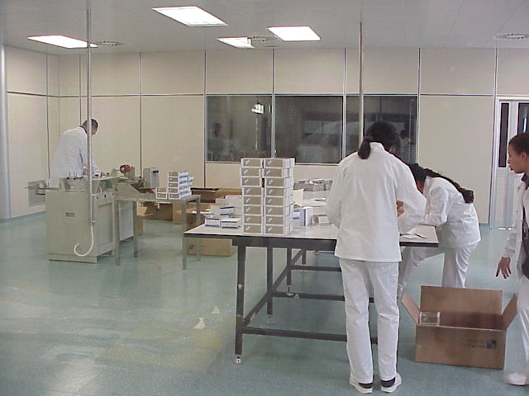
Is This an Opportunity?
YES, because it relates to the interaction of social and economic factors.

Slide 8
Social / Economic Factors
The technology transfer of medical devices involves complex economic and social aspects, which contribute to the development of the recipient country: the whole country receives social and economic benefits.
These benefits are not only related to establishing new industries, but especially to develop human resources, services and the standard of living, while improving existing science and technology to achieve self-reliance.
The human factor and the standard of living are a priority if we want to start the whole process of social and economic development in a society.

Slide 9
Technology Transfer - Channels
The first step of a technology transfer is the choice of the best possible channel; this depends upon many factors, the main issues being:
The availability of local financial and human resources;
The presence of local raw materials and services;
The choice of what degree of control is acceptable for the recipient country or organization.

Slide 10
Technology Transfer - Channels
There are three main accepted channels of transfer of manufacturing technology:
Joint venture agreements
licensing agreements
turn-key plants
RECIPIENT
CHANNELS
DONOR

Slide 11
Technology Transfer - Channels
A joint venture (JV) is a partnership arrangement between two or more parties to undertake economic activity together in order to manufacture or sell a product and to share profits and risks.
“A license means the consent given by the owner of an exclusive right (licensor) to another person or legal entity (licensee) to perform certain acts which are covered by an exclusive right, or consent as to use of know-how” (WIPO).
A turn-key plant is a manufacturing plant that is constructed by a technology donor and sold or turned over to a buyer in a ready-to-use condition.

Slide 12
Conclusion
The transfer of manufacturing technology within the domain of medical devices involves other concepts and algorithms, as the initial export of the device to the recipient country; a feasibility study needs to be carried out, involving a market study, knowledge of the local political environment, economy and local customs, capital outlays, production costs, financial analysis and a strategic marketing plan.

